Slide 1
ENERGY RESOURCEFUL BLUETOOTH SWAPPING IN ANDROID DEVICES
Presented by
S.SURIYAN
III-MCA-B
Guided by
Mr. D . PRABHAKARAN ,
AP-MCA.

Slide 2
ABSTRACT
Bluetooth has transformed itself from a cable replacement technology to a wireless technology that connects people and machines.
In this process we propose a noble system to reduce the power that is wasted during the practice of Bluetooth in a well proficient style.
Here we propose a system to communicate between two android devices independently without any intermediate.

Slide 3
EXISTING SYSTEM
The existing system has a lot of drawbacks like more power usage while Bluetooth is in use.
Data delivery from one device to another device requires intermediate to transfer the data packets.
The existing system tools show less efficiency in data packet delivery due to intermediate interference.
The chance of delay in delivering of data packets from one node to another due to network traffic is high.
The usage of Bluetooth is the device reduces the efficiency of the device and may affect the process of other tools

Slide 4
PROPOSED SYSTEM
The project is to develop an android application for data transfer in a network without any intermediate interference.
The devices between the ranges can communicate with the help of the developed android application.
The power consumption due to the use of the application is reduces efficiently to make the application more effective.
Data packets delivery is made more effective since there is no intermediate interference for packets delivery.

Slide 5
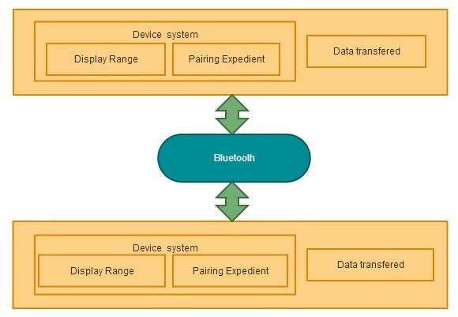
SYSTEM ARCHITECTURE

Slide 6
MODULES DESCRIPTION

Slide 7
NUMBER OF MODULES
Device Scanning
Device Authentication
Secure Transmitting
Connection Rescheduling
Energy reduction intended for Bluetooth convention

Slide 8
DEVICE SCANNING
In this module the application is intended to scan or sensor devices that are near by or reachable to the range of Bluetooth from the mobile device.
The devices are scanned with less energy consumption from the device to increase power efficiency during the processing of the system.
Once the sensing is completed the device lists all the devices that are available to communicate. Thus allowing us to select a device to communicate.

Slide 9
DEVICE AUTHENTICATION
Once the devices that are available are listed the device is chosen to communicate.
Once the device is chosen an authentication request is sent to the native device to accept the connection.
This is done internally to reduce complexity to the user who used the application.
The authentication is accepted by the native device and then only the communication connection is made between the two device.

Slide 10
SECURE TRANSMITTING
In this module, after the destination node is chosen from the device the packet that re required to be sent to the destination is made ready.
And later the packets are sent in the Bluetooth network that is established between the two devices.
The packets that are send is directly delivered to the destination without using any intermediate for communication.
Thus reliability and security is achieved higher in the application. Also the traffic is considerably high since this is a peer to peer connection.

Slide 11
CONNECTION RESCHEDULING
In this module the packets are received. Once the packets are sending from the source the packets travel through the Bluetooth network and reach the destination device.
The packets are received by the device and are processed. After processing the request the previous module is continued here to deliver packets from here to the source device.
Again the same process is repeated to deliver the packets.

Slide 12
ENERGY REDUCTION INTENDED FOR BLUETOOTH CONVENTION:
In this system the data communication between the devices is achieved using Bluetooth.
And the connection is peer to peer connection.
Here the energy used in the connection by the devices is made less in this module.
This is done by reducing the monitoring time of devices in the network often.
Here the monitoring is reduced and when ever needed it is implemented. Thus it helps in reducing the power consumption. Thus the system is made energy efficient.

Slide 13
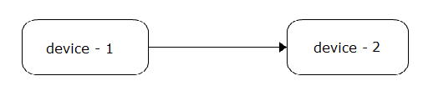
DATA FLOW DIAGRAM LEVEL-1

Slide 14
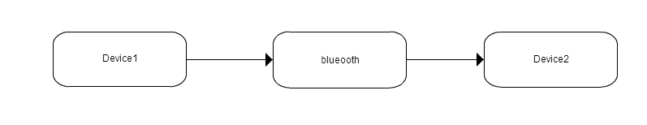
DATA FLOW DIAGRAM LEVEL-2

Slide 15
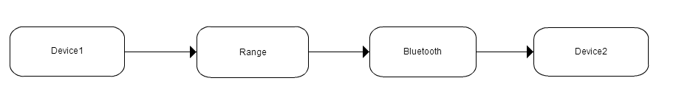
DATA FLOW DIAGRAM LEVEL-3

Slide 16
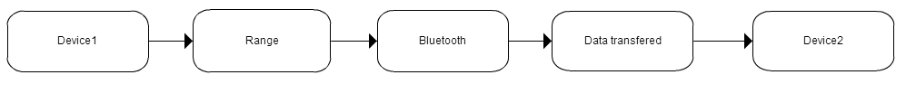
DATA FLOW DIAGRAM LEVEL-4

Slide 17
SAMPLE CODE

Slide 18
onRESUME
public void onResume()
{
this;
JVM INSTR monitorenter ;
super.onResume();
setImage(appPrefs.getBG());
items = appPrefs.getQuickText().split("XXXX");
Log.e("BluetoothChat", "+ ON RESUME +");
if (mChatService != null && mChatService.getState() == 0)
{
mChatService.start();
}
this;
JVM INSTR monitorexit ;
return;
Exception exception;
exception;
throw exception;
}

Slide 19
onSTART
public void onStart()
{
super.onStart();
Log.e("BluetoothChat", "++ ON START ++");
if (!mBluetoothAdapter.isEnabled())
{
startActivityForResult(new Intent("android.bluetooth.adapter.action.REQUEST_ENABLE"), 2);
} else
if (mChatService == null)
{
setupChat();
return;
}
}

Slide 20
onSTOP
public void onStop()
{
super.onStop();
Log.e("BluetoothChat", "-- ON STOP --");
}

Slide 21
setIMAGE
void setImage(String s)
{
File file;
file = new File(s);
if (!file.exists())
{
break MISSING_BLOCK_LABEL_75;
}
ByteArrayOutputStream bytearrayoutputstream = new ByteArrayOutputStream();
android.graphics.BitmapFactory.Options options = new android.graphics.BitmapFactory.Options();
options.inSampleSize = 2;
android.graphics.Bitmap bitmap = BitmapFactory.decodeFile(file.getAbsolutePath(), options);
bytearrayoutputstream.flush();
bytearrayoutputstream.close();
bg.setImageBitmap(bitmap);
appPrefs.saveBG(s);
return;
IOException ioexception;
ioexception;
Toast.makeText(getBaseContext(), "Please select small image", 1).show();
ioexception.printStackTrace();
return;
}

Slide 22
OUTPUT SCREENSHOTS

Slide 23
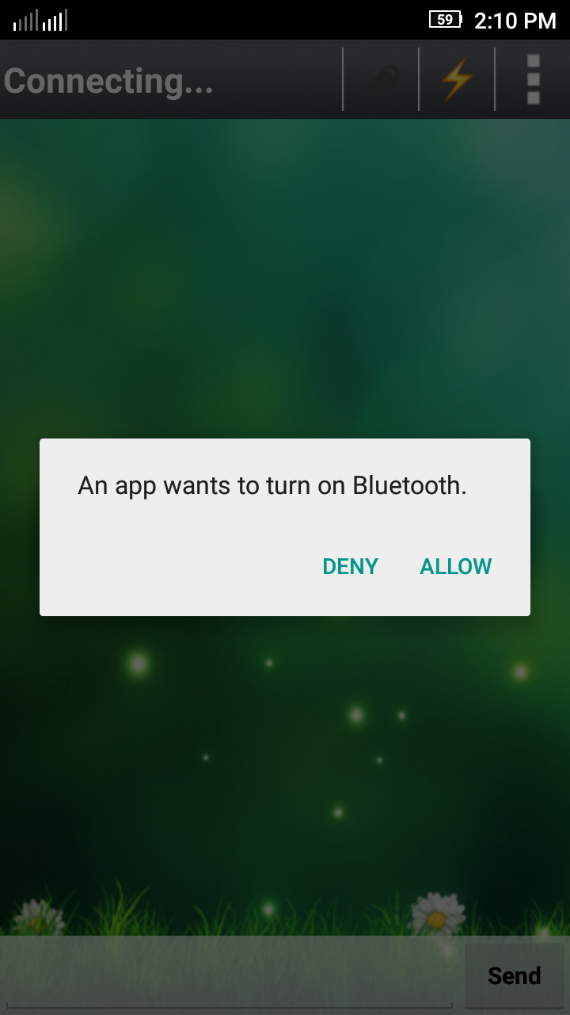
TURN ON BLUETOOTH

Slide 24
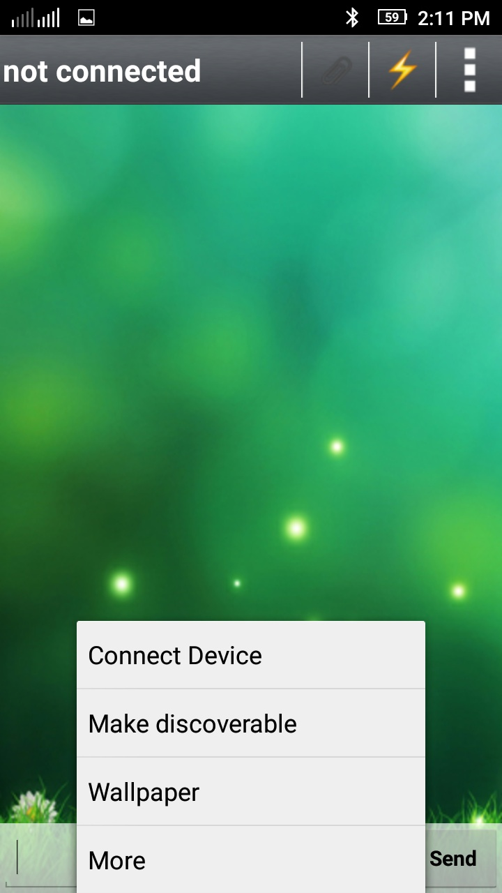
OPTIONS

Slide 25
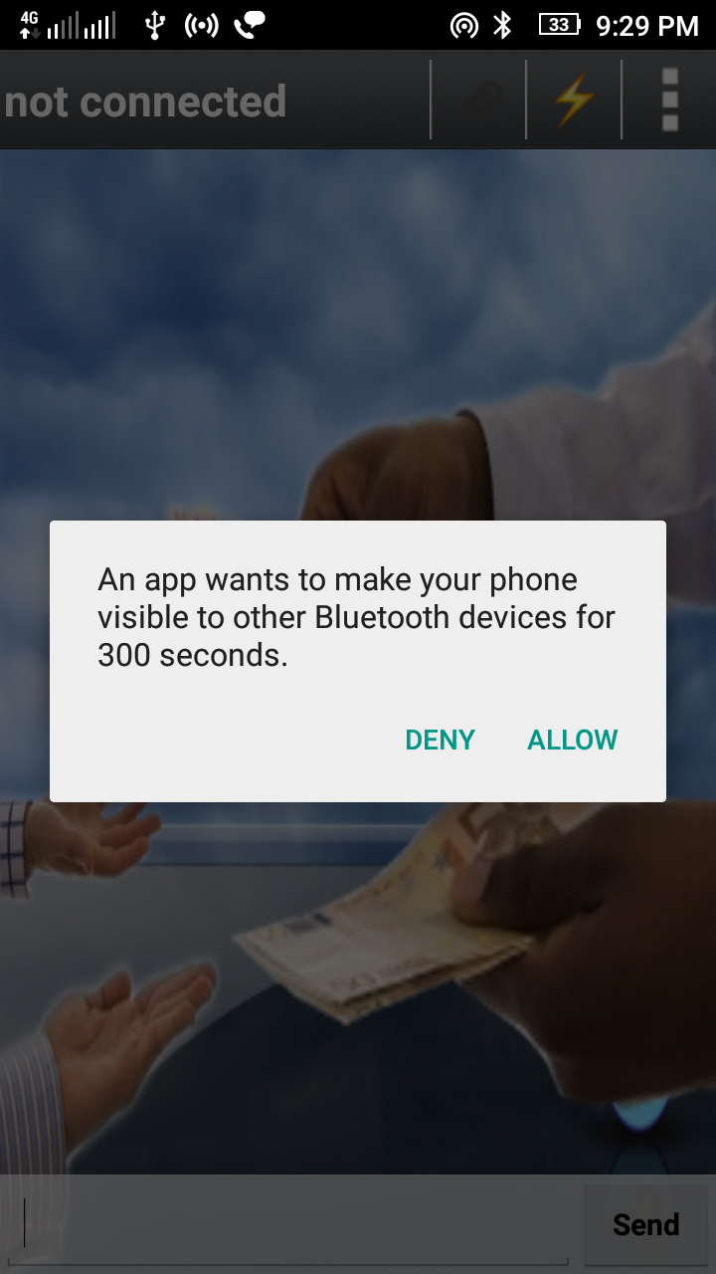
MAKE DISCOVERABLE

Slide 26
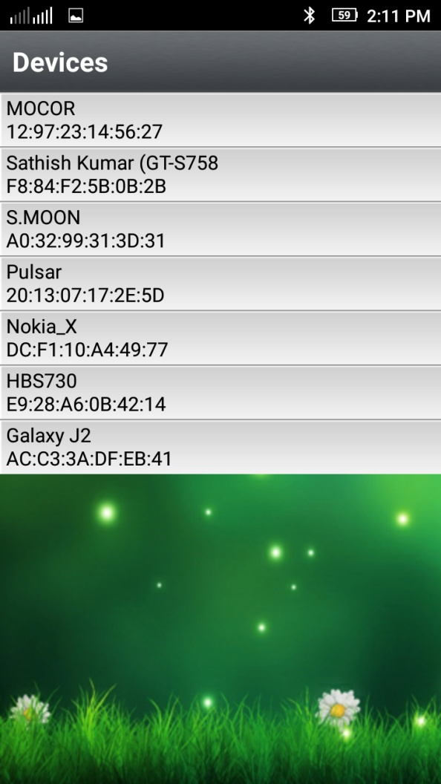
NEARBY DEVICES

Slide 27
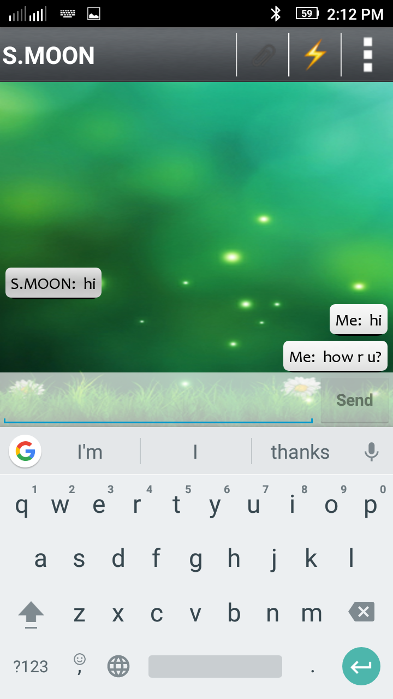
CONNECTED TO COMMUNICATE

Slide 28
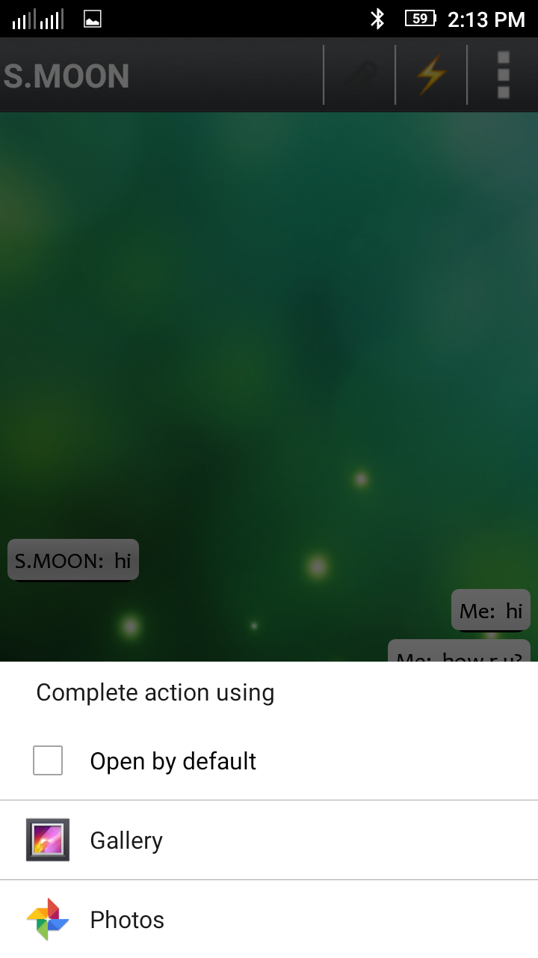
CHOOSING FILE

Slide 29

WALLPAPER

Slide 30
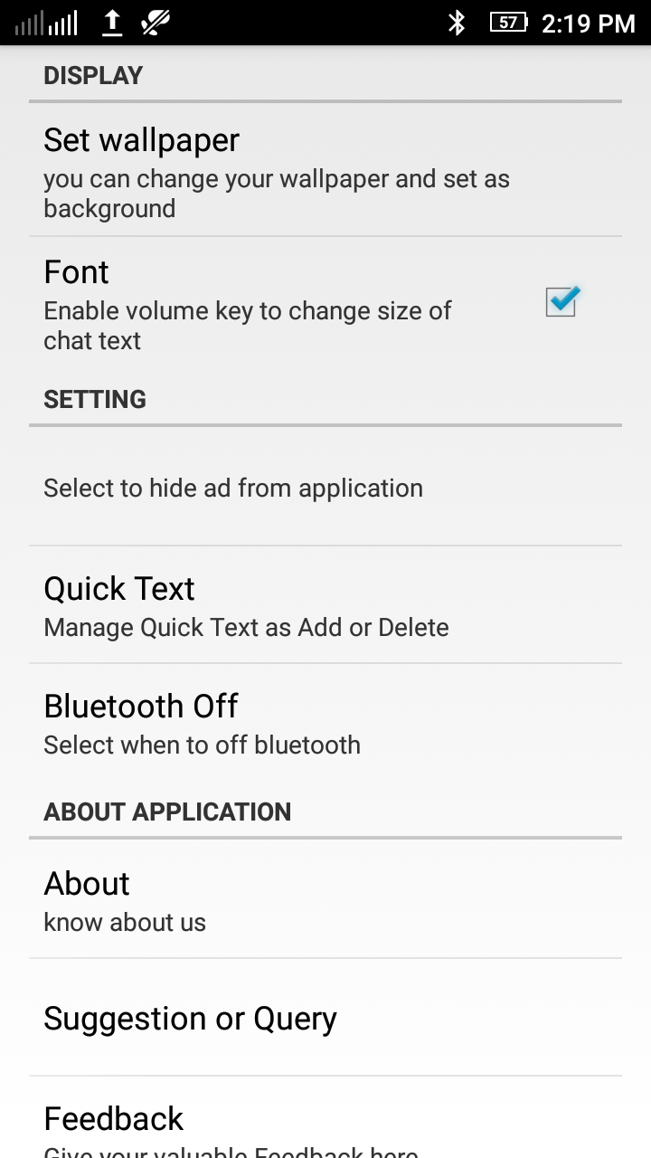
SETTINGS

Slide 31
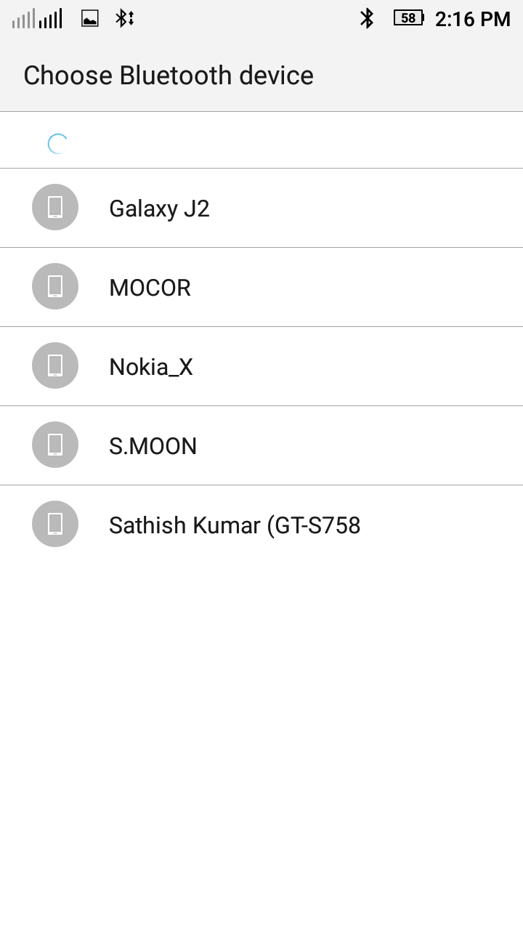
SELECT BLUETOOTH DEVICE

Slide 32
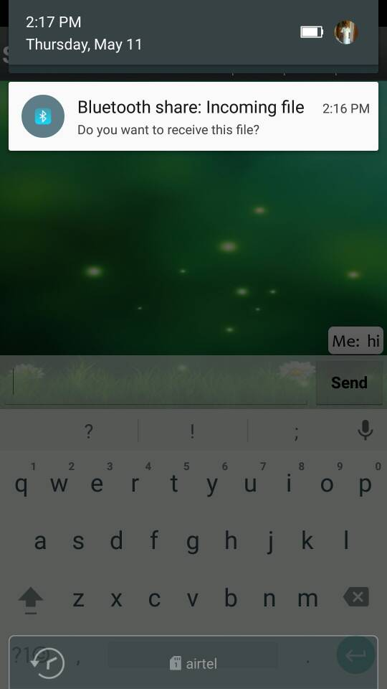
RECEIVING FILE

Slide 33
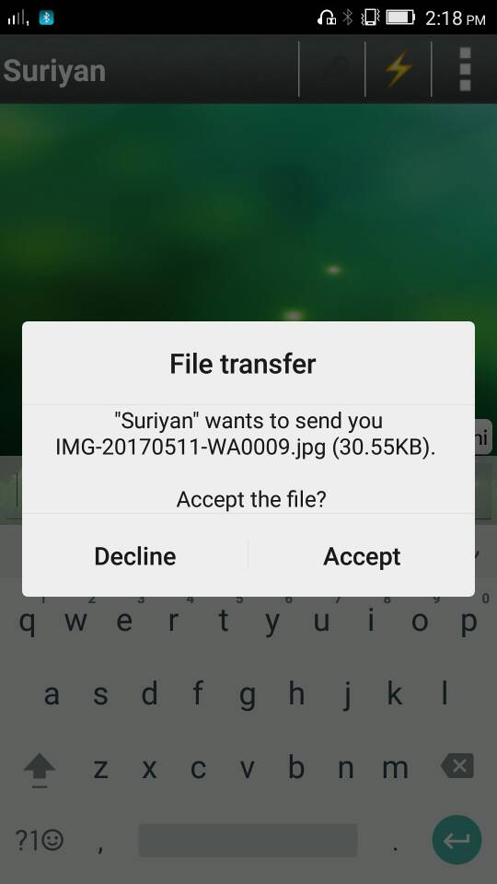
PROMPT TO CONFIRM THE RECEIVING

Slide 34
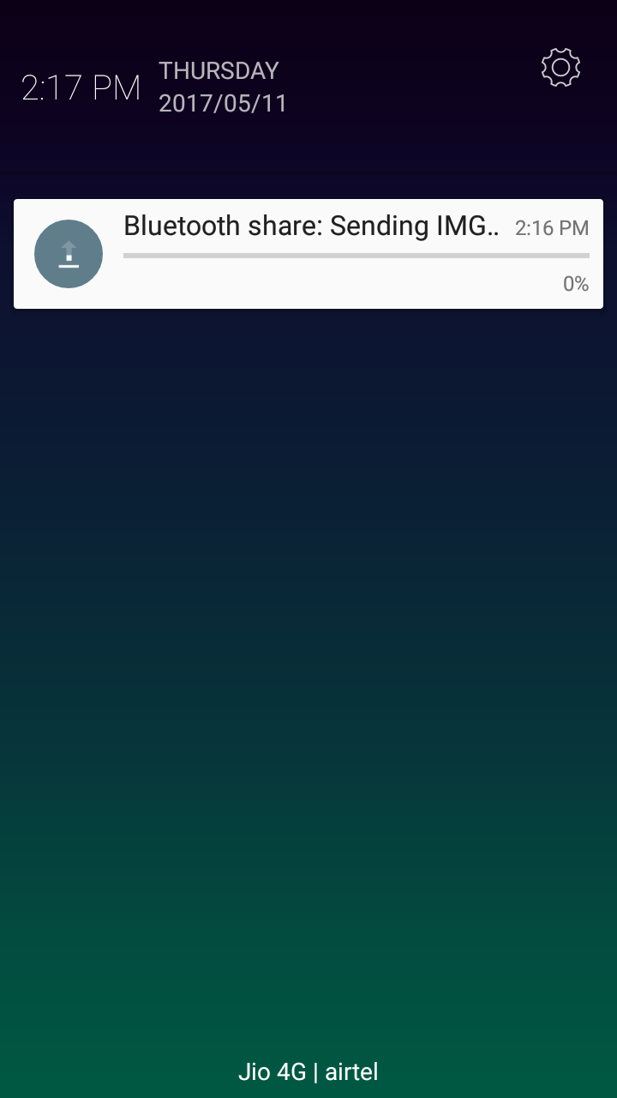
SENDING FILE

Slide 35
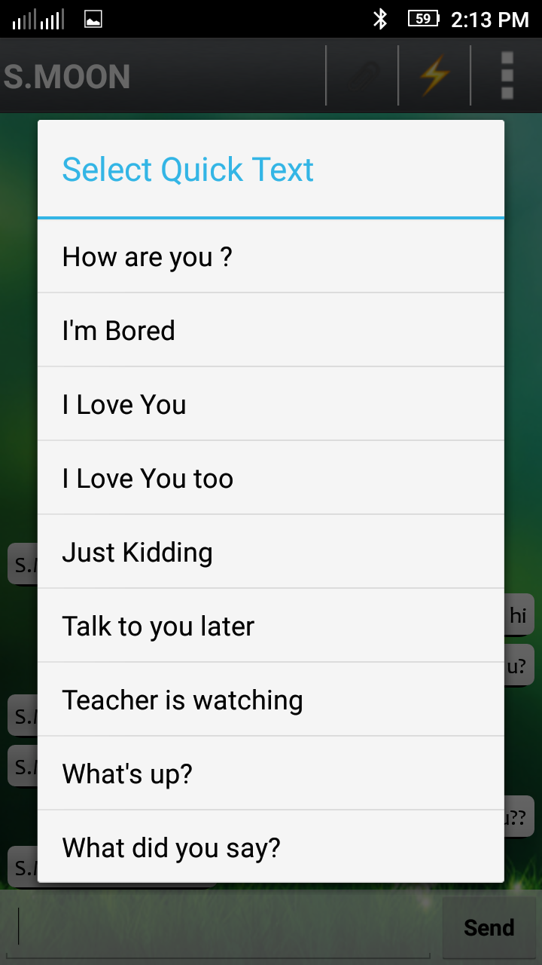
QUICK TEXT

Slide 36
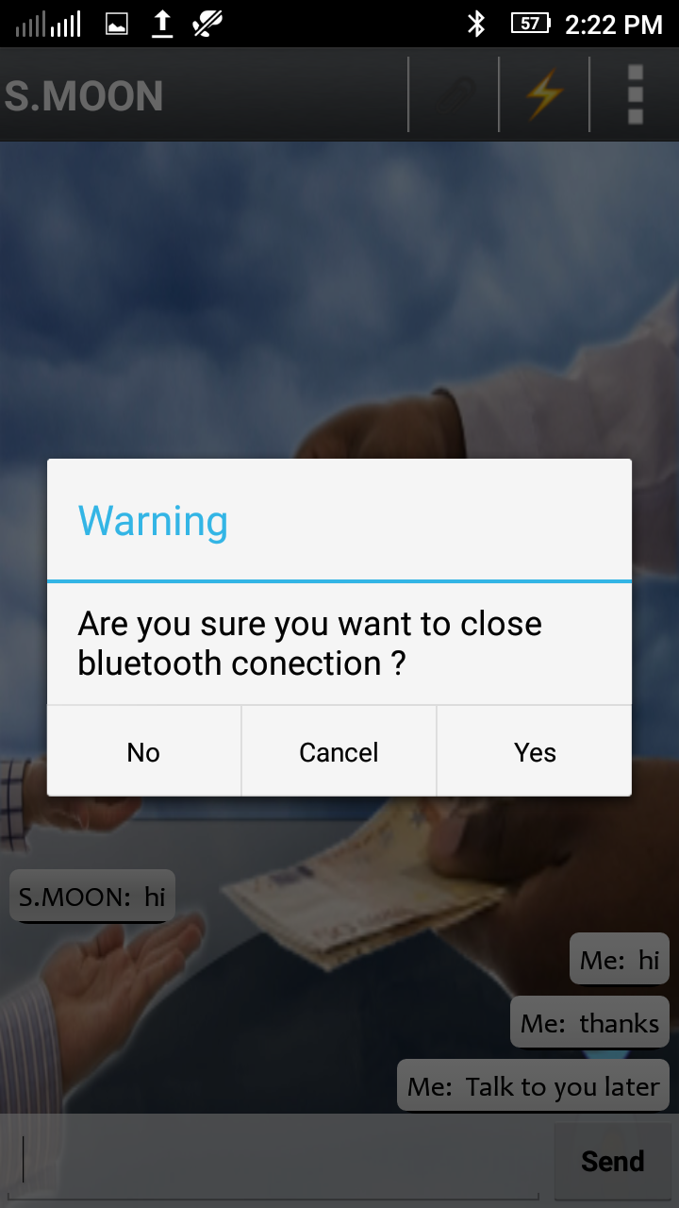
WARNING

Slide 37
CONCLUSION:
All the problems in the existing system where analyzed and has overcome in the proposed system as well.
The project is designed in a user friendly way. All the requirements are met and fulfilled.
The project shows well reliable data transfer rate.
The data’s are transferred and maintained in secure manner.
The project shows reliable data transfer and also show reliable power consumption.

Slide 38
THANK YOU

